Slide 1
Professional Practices(IT)
INTRODUCTION

Slide 2
Introduction (Faculty Member)
Mr. Usman Shehzaib (Assistant Professor)
Email address: usmanshehzaib@cuilahore.edu.pk
Office: Room No 17(C-Block)
Office Hours: Tuesday- [12:00-01:30] Friday-[10:00-12:00]

Slide 3
Course Objective:
The aim of this course is to give foundation to students:
to make an appropriate decision in their professional lives and make a positive impact on the field of IT
To handle difficult situations involving
Ethical issues,
Violation of professional code of practices,
Legal issues,
Privacy boundaries,
Cyber and workplace crimes

Slide 4
Course focus
Ethics
Privacy
Cyber and work place crimes
Freedom of speech
Intellectual property law
Research Ethics
Professional Ethics and Responsibilities
Ethically building secure software

Slide 5
Marks Distribution
1st SESSIONAL → 10%
2nd SESSIONAL → 15%
Final EXAMS → 50%
QUIZES (4-5) → 15 %
Assignments (4-5) → 10%

Slide 6

How to Succeed
Expect to spend approximately 10-15 hours per week on this course
Be attentive in class
80% Attendance is mandatory
Participate in class
Read the book and the resources

Slide 7
A reminder on plagiarism
Do not copy material (Quiz, homework) without attribution
Plagiarism is cheating; the minimum penalty will be a zero for the assignment
Your work should be your own
If you have any questions, ask the instructor

Slide 8
Required Textbook
Sara Baase (2013), A Gift of Fire, Social, Legal, and Ethical Issues for Computers and the Internet, 4th Edition, Prentice-Hall.

Slide 9
Today’s Objectives
Course overview
Required textbooks
Syllabus and schedule
How to succeed
Basic concepts
What is IT?
Who is IT Professional?

Slide 10
What is Information Technology?
?

Slide 11
Information Technology (IT)
A modern technology which deals with the Retrieval & Processing of useful Data.
Fact:
Even World is separated on the basis of “Technology Boundary” i.e. Technologically advance and “Backward Countries”.

Slide 12
Who is IT Professional?
?

Slide 13
Who is IT Professional?
You are an IT Person, going to be an IT professional.

Slide 14
Problem faced by IT Students
Lack of Knowledge about where Computer Science exists (Areas and Business Sectors) ?
There Global/Local Market Worth.
Lack of Motivation in CS Enrolled Students.
Under What Job roles they will be utilized (Classification of career opportunities )?
What skills they need to gain during CS degree ?

Slide 15
Possible Sectors for CS
Students need to know how varied and lucrative a career in IT can be.
All businesses today, and in the future, will rely IT
for most technology is at the core of whatever they do
whether they operate in retail, manufacturing, financial services, the arts, or virtually any other discipline.
With the right computer science skills young people can find work in any industry, in any sector and in any position.

Slide 16
Worth of IT person in market
Employment opportunities are expected to increase 19% between 2010 - 2020.
The average salary for the most in-demand positions for CS/SE majors is about $89,000 per annum.
Who is hiring and where are the jobs?
Indeed.com
Rozee.pk
And many others…

Slide 17
Why people Fail to proceed in IT field?
?

Slide 18
Why people Fail to proceed in IT field?
Lack of motivation
Choosing the wrong career
Unclear purpose
Destructive thinking
Not focusing on strengths
Over-estimating your success
Old curriculum
Bookish knowledge
Invisibility of the field

Slide 19
How to overcome these issue?
Motivate the students
ICT curriculum should reflect the modern age.
Move from know how of “basic desktop applications and hardware” towards more involved concepts such as “programming or networking”.
Increase Skills that will be in most demand in the coming decades like:

Slide 20
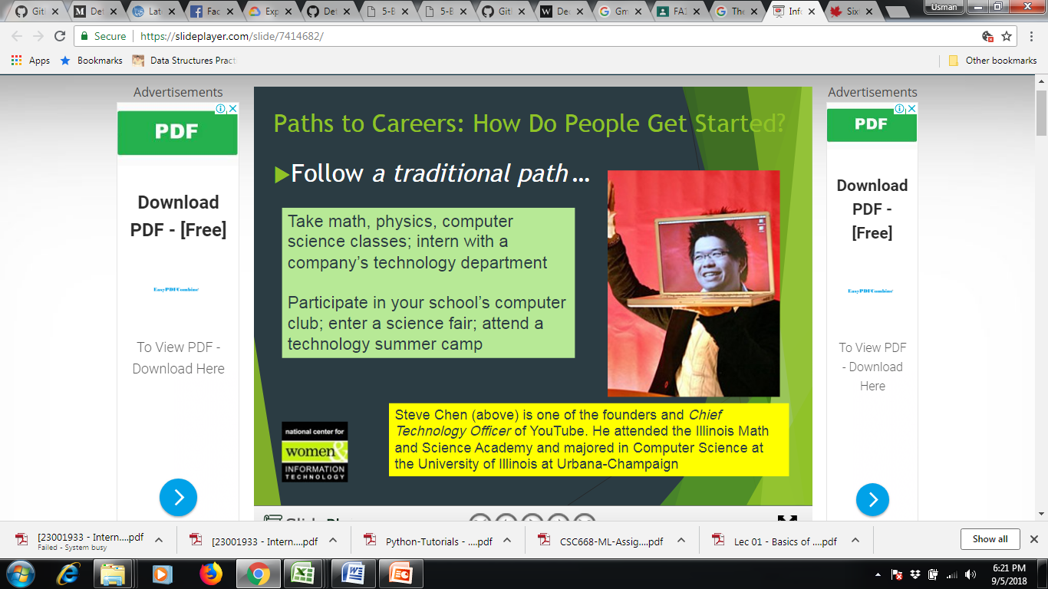

Slide 21
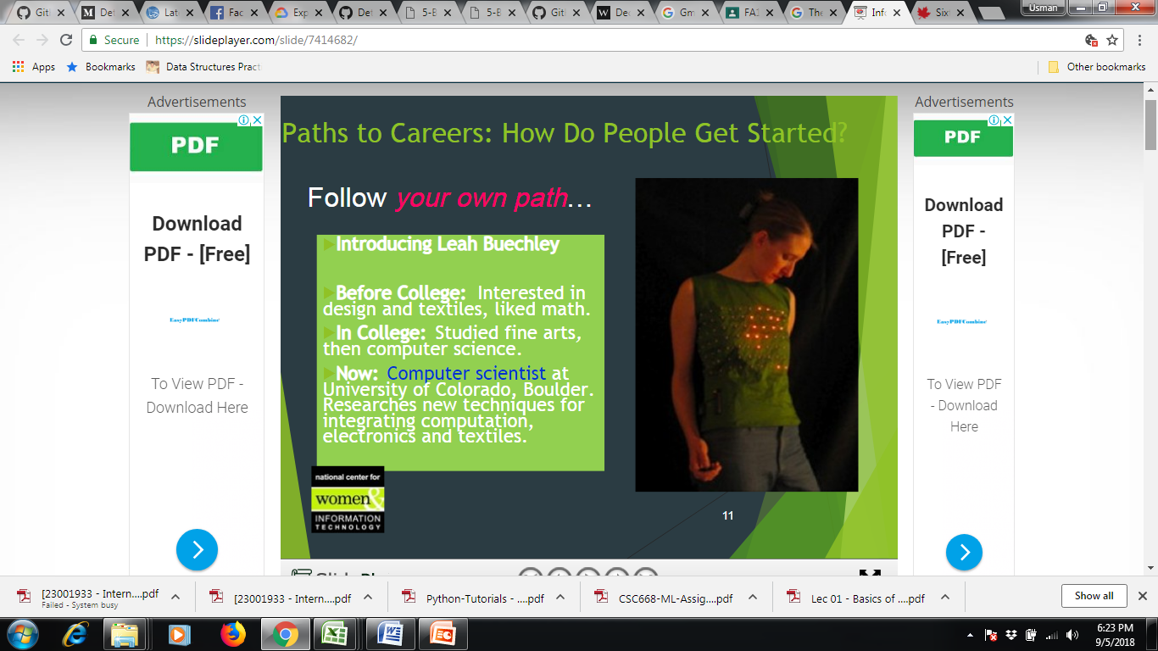

Slide 22
Classification of Career opportunities
Career opportunities for CS are divided into 7 categories:
Programming and software development
Web and Internet
Graphics and multimedia
Information systems operation and management
Telecommunications and networking
Training and support
Computer science research
Computer industry specialists

Slide 23
8 TOP TECH SKILLS IN DEMAND IN 2018
MACHINE LEARNING (Average salary: $135K+ (Machine Learning Engineer)
MOBILE DEVELOPMENT(app economy predicted to be worth $6.3 trillion by 2021
SEO/SEM MARKETING (top five organic search results get over 75% of the clicks)
DATA VISUALIZATION(bringing the power of Big Data to the mainstream)
Data Engineering( has historically outpaced growthfor data scientist jobs)
UI/UX DESIGN (design interfaces for websites and apps to be visually appealing)
NETWORK AND INFORMATION SECURITY (damage from cyber crimes are anticipated to cost the world $6 trillion annually by 2021)
Cloud computing (cloud platforms, featuring content delivery, database storage, networking, and more–over 50 services in total)
Resource:
https://www.technojobs.co.uk/info/career-advice/top-10-it-skills-and-tech-skills-for-2020.phtml
Also visit above all links for further details

Slide 24
Skills need to gain during Graduation
The UK lacks technical skills,” it said, adding that “the current pipeline of graduates and practitioners would not meet demand.”
The National Audit Office (NAO) suggested that it could take up to 20 years to close the IT security skills gap.
The average salary of AWS-certified IT professionals is 27.5% higher than the norm.
AWS Average salary: $114,000 (in the top 5 highest-paying certifications in the United States and Canada

Slide 25
Assignment: 1
1 Page CV Writing.
Job area selection with Job Definition
I page Reason behind its selection (Research which you have made to decide your area)

Slide 26

Tip:
Keep count on your skills by building your 1st CV.
< http://www.myperfectresume.com >
Starting from semester 1 keep adding your
“Subject projects” which are relevant to your job interest area.
In Final year add details of your “Final year Project”.
Add it up with “internship” as an experience.

Slide 27
Conclusion
Introduction to course objectives and focus of the course
Course hand book and grading criteria
Revision of basic concepts
Introduction to IT
IT Professional and IT professions

